Slide 1


Quote Generator App
Notes:
In this presentation, we will discuss the Quote Generator Web App, a web-based application that allows users to generate random quotes. Quotes can be a great source of inspiration, motivation, and wisdom. They can also be used to start conversations, add humor to presentations, or simply brighten someone's day. The Quote Generator Web App makes it easy to find the perfect quote for any occasion.

Slide 2

OBJECTIVE
The primary objective of our project was to create a platform that not only delivers random quotes but also enhances the user experience through smooth functionality.
HOW IT WORKS
The Quote Generator Web App is a simple and easy-to-use web application.
To generate a quote, simply click the "Generate Quote" button.
A new quote will be displayed on the screen, along with the author's name.

Slide 3
BENEFITS OF QUOTE GENERATOR
Find inspiration and motivation
Get a new perspective on things
Start conversations
Add humor to presentations
Brighten someone's day
Notes:
There are many benefits to using the Quote Generator Web App. Quotes can be a great source of inspiration and motivation. They can help you to see things from a new perspective and to think more creatively. Quotes can also be used to start conversations, add humor to presentations, or simply brighten someone's day.

Slide 4
Key Features
User Interface: A user friendly interface makes it easy for users to interact with the app and generate quotes effortlessly. The app boasts a visually stunning user interface with a modern design and vibrant color scheme.
Animation: Incorporated engaging animations, such as the rotating reload button, to add a playful element to the user experience.
Dynamic Content: Implemented asynchronous fetching of data from an external API to dynamically update and display random quotes.
User Engagement: Integrated a 'Generate Quote' button to trigger the quote fetching process, ensuring a seamless and enjoyable user journey.
Loading Experience: Introduced a loader with animated bars to provide users with visual feedback during the API fetching process, enhancing the overall loading experience.

Slide 5
Technological Proficiency
Frontend Development: Developed the frontend using HTML and CSS to structure and style the web page.
Loading Animation: Overcame the challenge of implementing loading animations by incorporating CSS animations for a smooth and engaging visual experience.
Utilized JavaScript for asynchronous communication with the external API, ensuring real-time quote updates.

Slide 6
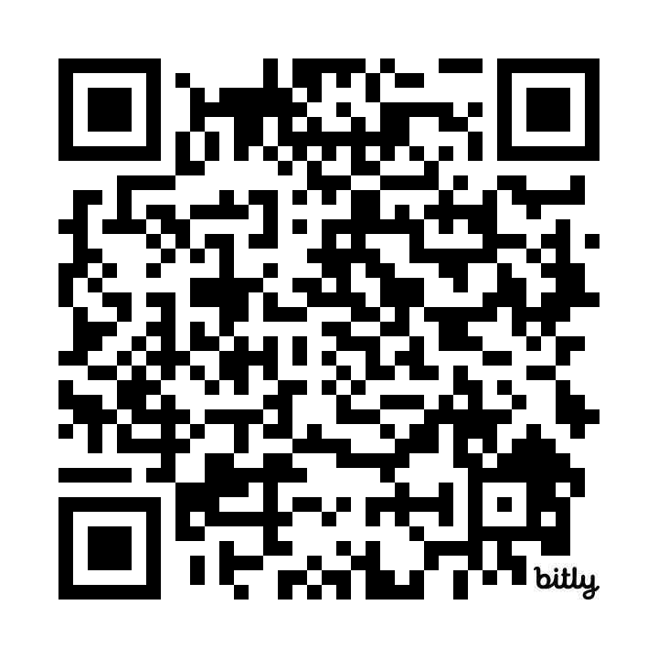
LIVE PREVIEW
https://random-quote-generator-lac.vercel.app/

Slide 7
Future Enhancement
As we move forward, we envision incorporating additional features such as user customization, a wider range of quote categories, and social media sharing capabilities to further enhance the app's value and appeal.

Slide 8
Conclusion
Our Quote Generator App successfully marries design aesthetics with seamless functionality.
By combining technology, design principles, and user-centricity, we've created an application that not only fulfills its core functionality but also elevates the user experience.
The interactive and visually pleasing nature of our app makes it a standout project in the realm of web development.

Slide 9
Thank You
We extend our gratitude for the opportunity to work on this exciting project and present our creative and technical skills.
Thank you for your attention, and we look forward to any questions or feedback.

